Slide 1
GLOBAL HEALTH EXPENDITURE ANALYSIS (POWER BI DASHBOARD)

Slide 2
INTRODUCTION
Objective: To analyze and compare healthcare expenditure patterns across countries and regions.
Years Covered: 2000–2020.
Tool Used: Microsoft Power BI for interactive analysis and visualization.

Slide 3
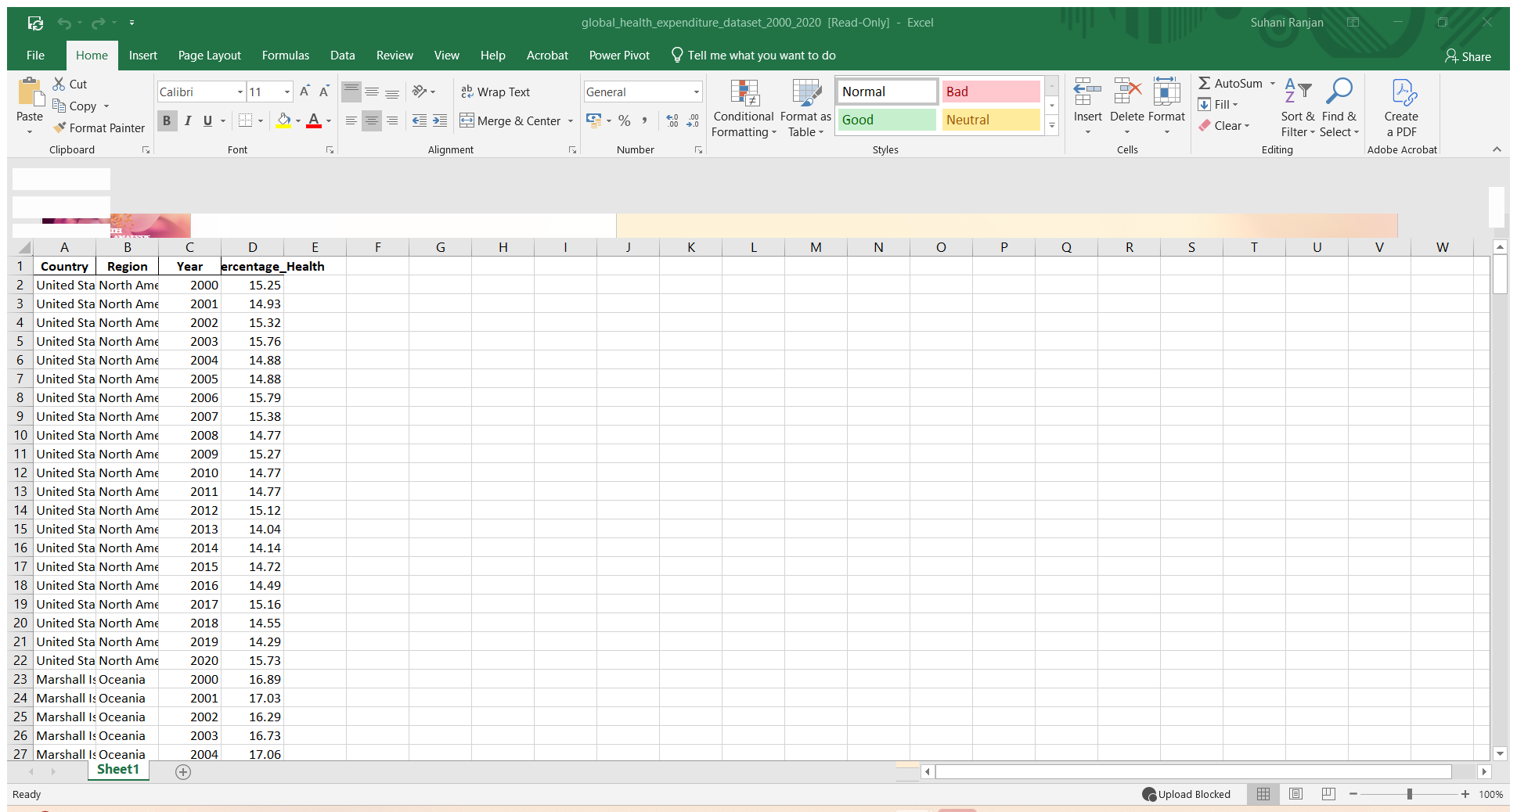
DATASET OVERVIEW
Fields Used: Country, Region, Year (2000–2020), Expenditure, % of GDP.
Sample Size: ~10+ countries across multiple regions.
Data Cleaning: Removed nulls, standardized values, Created DAX Formulas.

Slide 4
KPI CARDS AND VISUALS
KPI CARDS
VISUALS
Total Expenditure Average
Expenditure per Country
YoY Growth % Top Country
• Clustered Bar Chart - Top 10 Country by Expenditure.
• Donut Chart - Total Expenditure by Region.
• Line Chart - Total Expenditure by Year.
• Shape Map - Total Expenditure by Country and Region
• Enlighten World Flags
• Ribbon Chart - Max and Min Expenditure by Country
• Pie Chart
• Table
• Stacked Bar Chart - GDP Percentage Health by Country

Slide 5
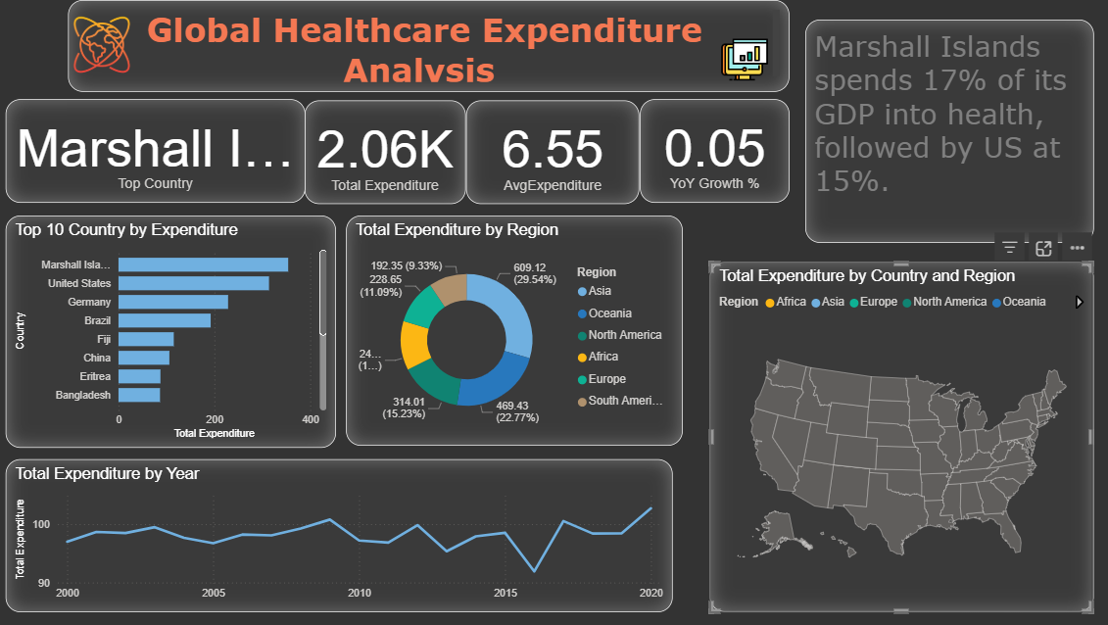
DASHBOARD PAGE-1

Slide 6
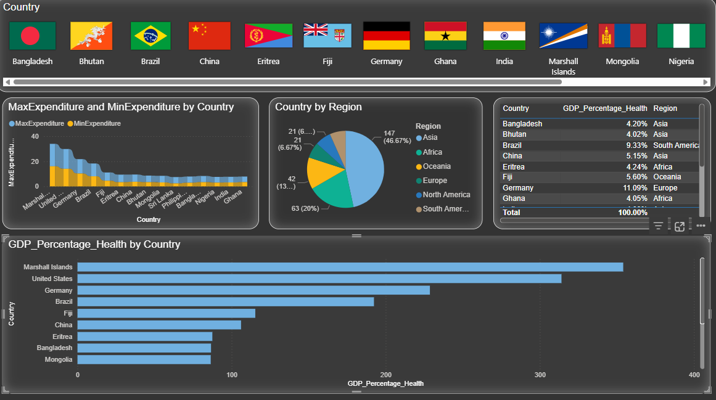
DASHBOARD PAGE-2

Slide 7
INSIGHTS AND CONCLUSION
KEY INSIGHTS
Global healthcare expenditure shows a steady upward trend (2000–2020).
Marshall Islands (17%) and USA (15%) spend the highest % of GDP on health.
Germany and Brazil also rank among the top spenders.
Regional analysis: Asia contributes ~47% of total expenditure, followed by Europe and North America.
CONCLUSION
Need to balance healthcare investments across low-spending countries.
Further analysis can include per-capita expenditure and healthcare outcomes.

Slide 8
THANK YOU
SUHANI RANJAN
INDIAN INSTITUTE OF TECHNOLOGY PATNA

